Slide 1
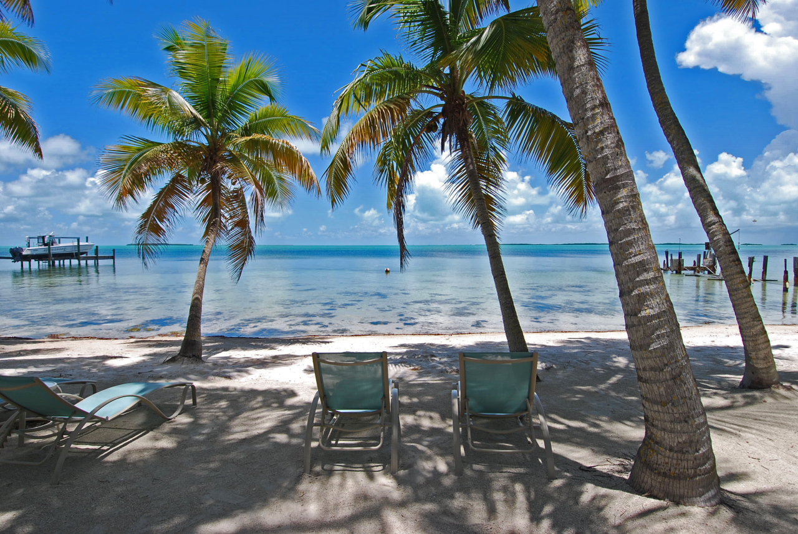

SUP-Yoga
Spring Break 2017

Slide 2
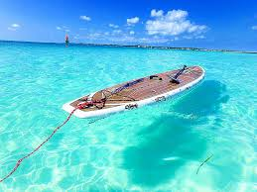
Are you ready to enjoy a laid back ride through the Florida Keys?
Join Us! March 18, 2017 Key Largo, Florida

Slide 3
Explore the hidden views and lagoons on our SUP-Yoga class through the Keys!

Slide 4
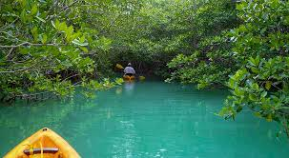
Our SUP-Yoga is SATURDAY from 10 - 11:30 AM!

Slide 5
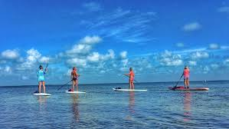
Order group pictures with your friends to re-live the memories!

Slide 6
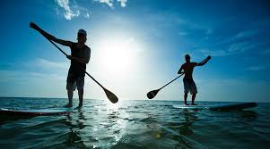
Morning Paddle Rides Are A Crowd Favorite!

Slide 7
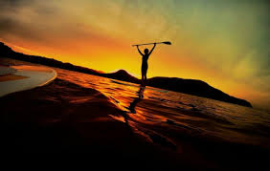
Take a morning off and enjoy some SUP-Yoga as the sun rises!

Slide 8
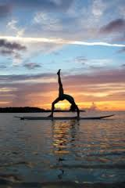
RELAX!

Slide 9
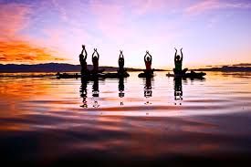
Find Peace Within Yourself!

Slide 10
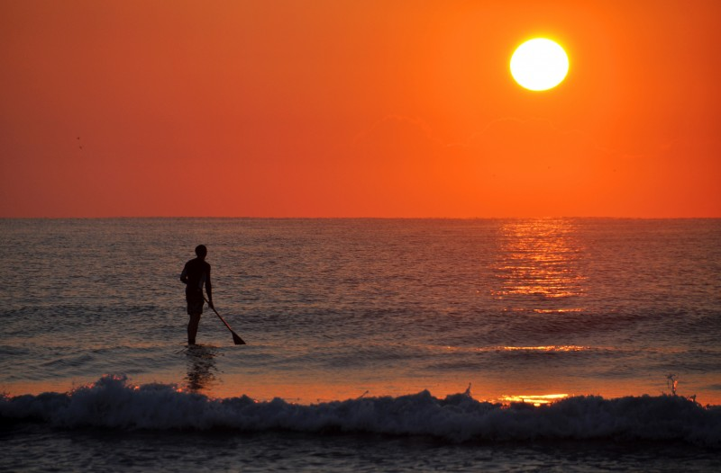
Paddle your way into happiness!

Slide 11

Join the fun and use our snap filter when connecting with friends!

Slide 12
Don’t leave without experiencing the amazing views our Paddle Boarding trips will take you through!
Follow us now on: Twitter, Instagram, Facebook, & Snap Chat @SUP-Yoga. Use our hashtag #SupYogaKL to connect with us!

Slide 13
SUP-Yoga wants to thank you for visiting the Florida Keys!

